Slide 1
MXV- PY (image processing program )
MXV- Automation team
31/11 /2022

Slide 2
No. | Ver.

Slide 3
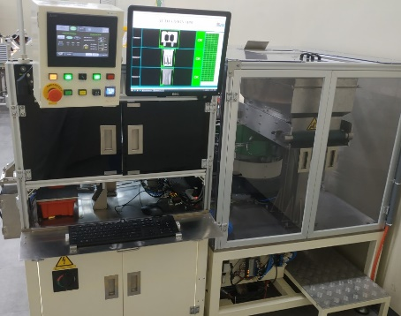
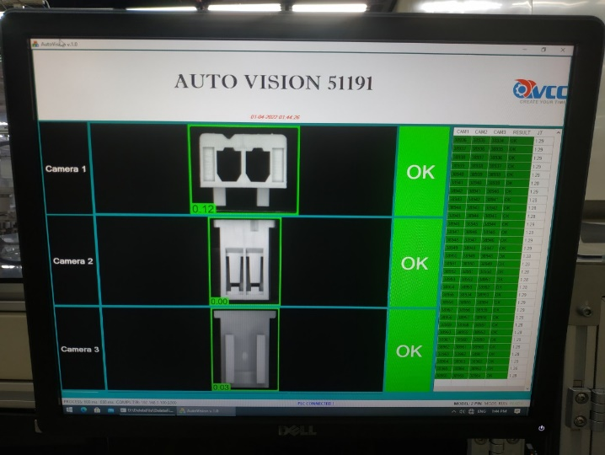
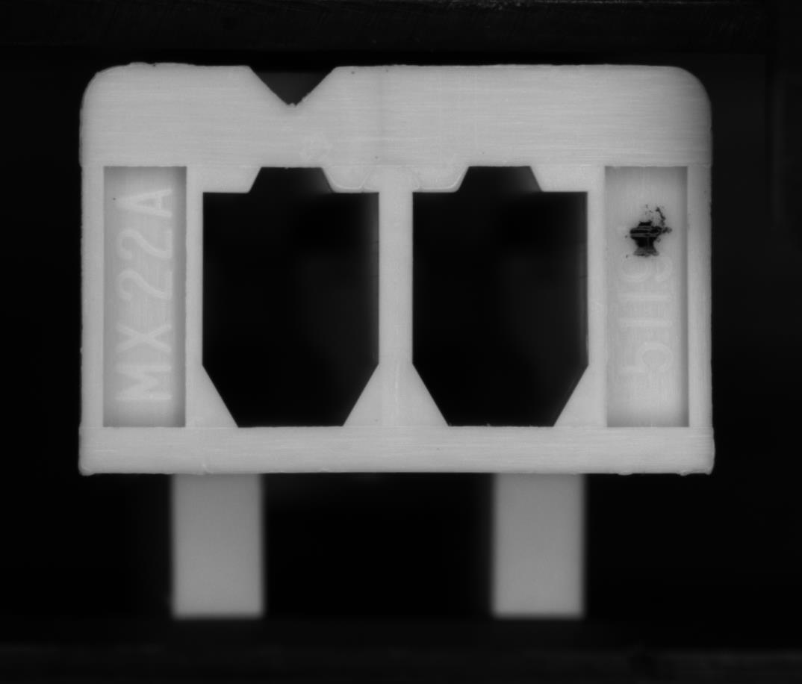
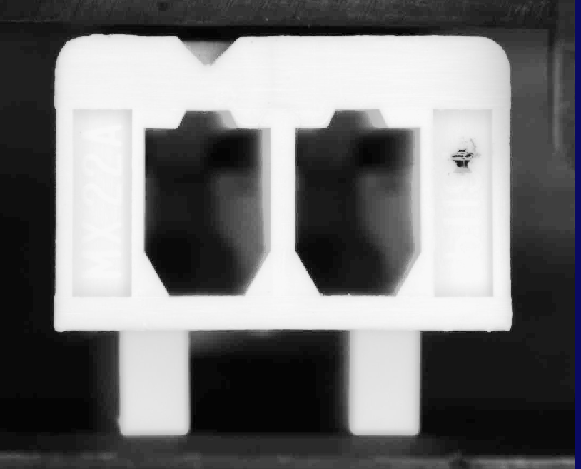
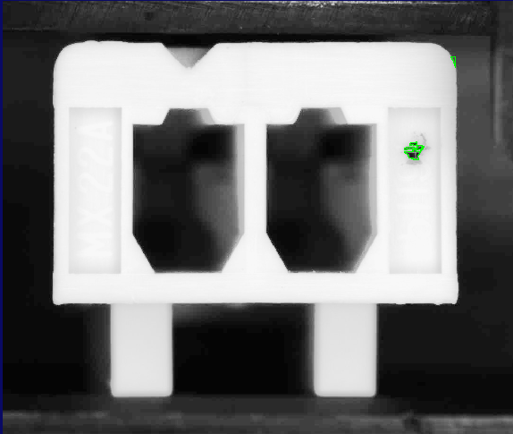
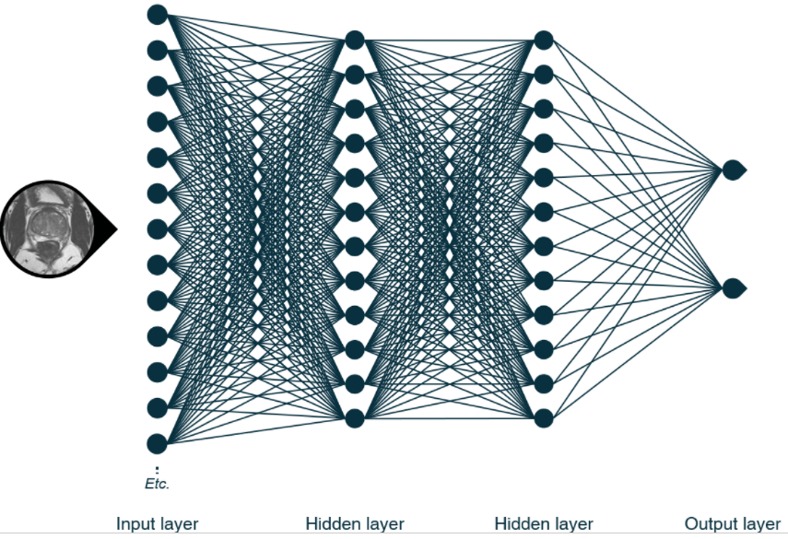
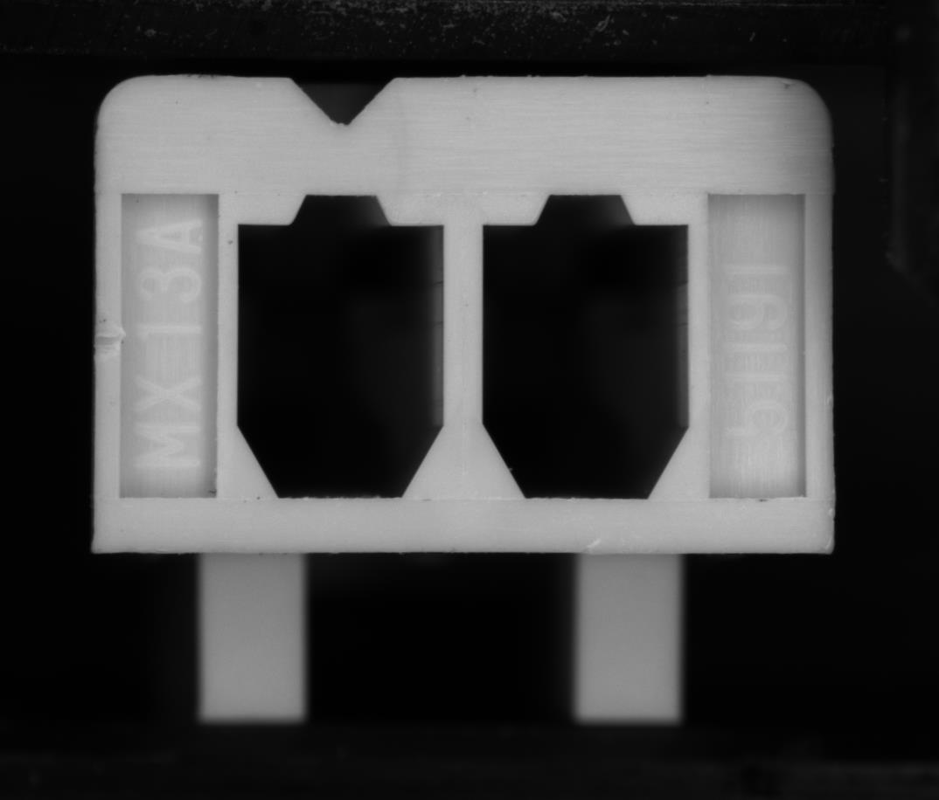
I, Over view machine : Vision check appearance 91191 Multi model (2-15 ckt) :
1. Over view:
Hardware : Basler camera , VST lighting , PC HP Z4 workstation.
Software : Cognex Vidi, Cognex vison pro .
Abilities : Detect ~ 20 type NG of molding ( short mold , shape NG , dust…)
Only deep learning can solve this case .
Cycle time of vision : 1.3 s/pcs (3 camera)
51191 machine
2. How it works:
NORMAL VISON :
Input image
Deep Learning
Image filter
Area checking
One by one
Input image( OK ,NG)
Model deep learning
Output
Blob functions
0.094 NG
Difficult apply many type NG .
Can’t check all NG types
Specs unstable
Compare spec and judgement
0.03 OK

Slide 4


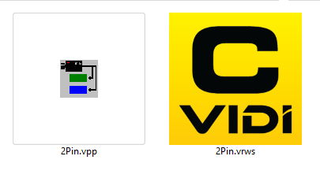
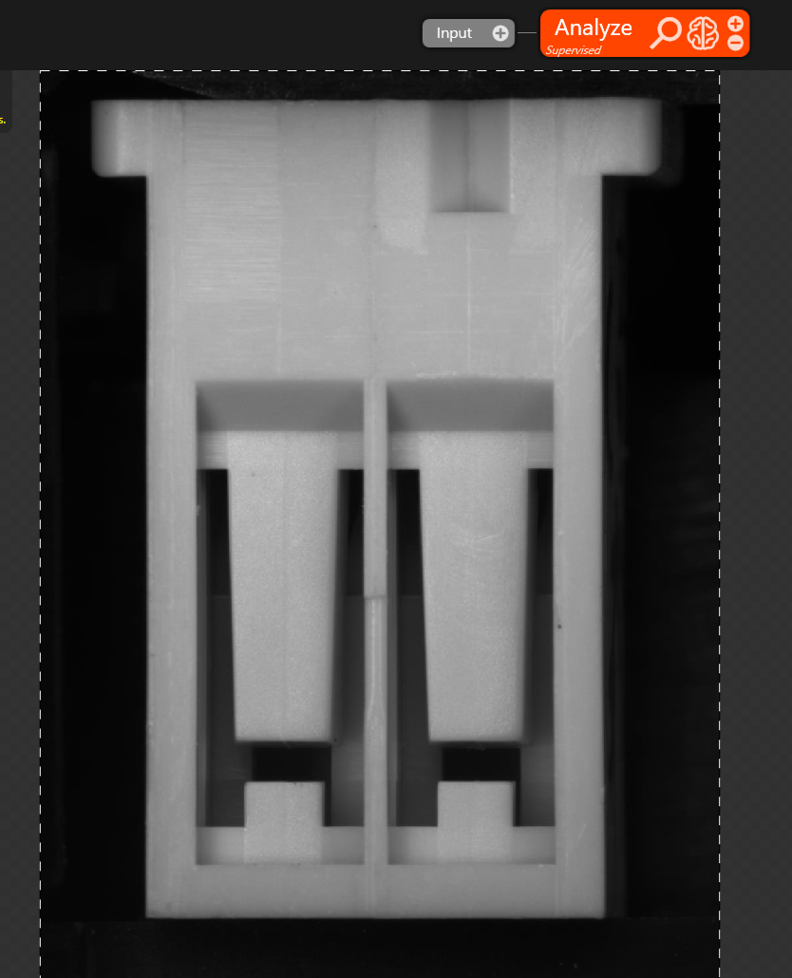
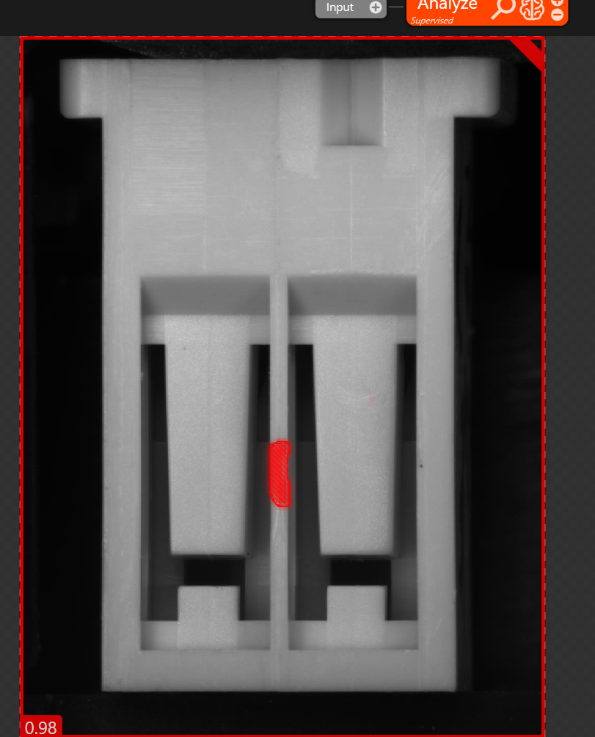
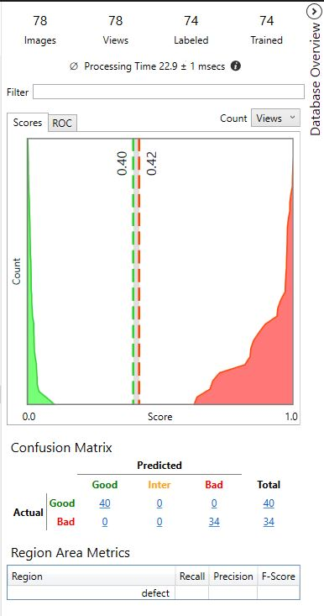
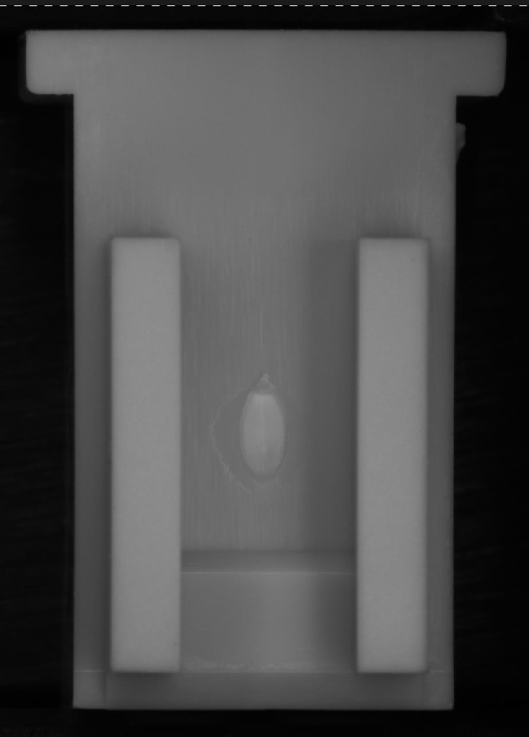
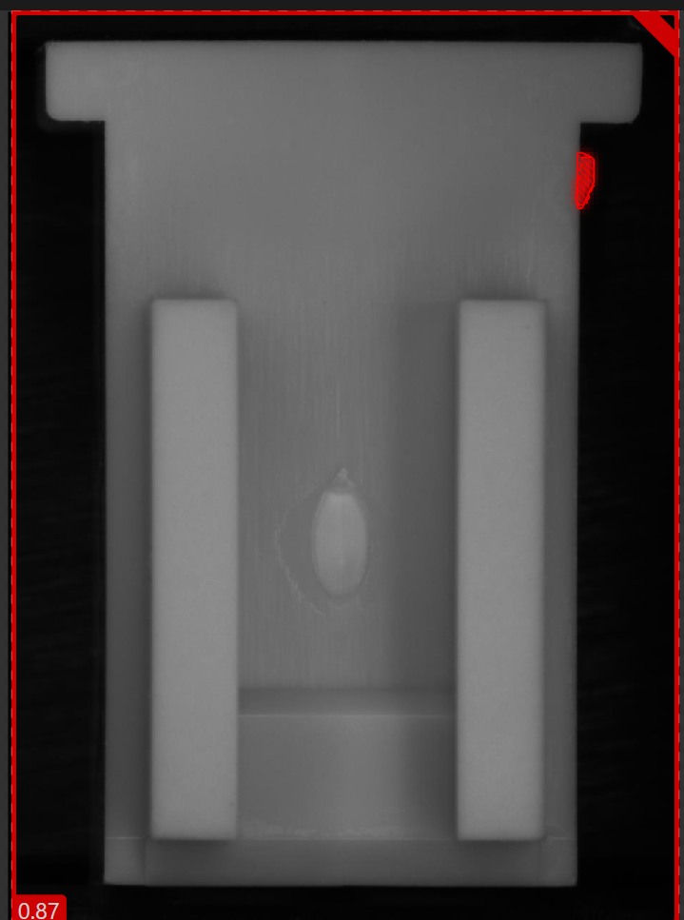
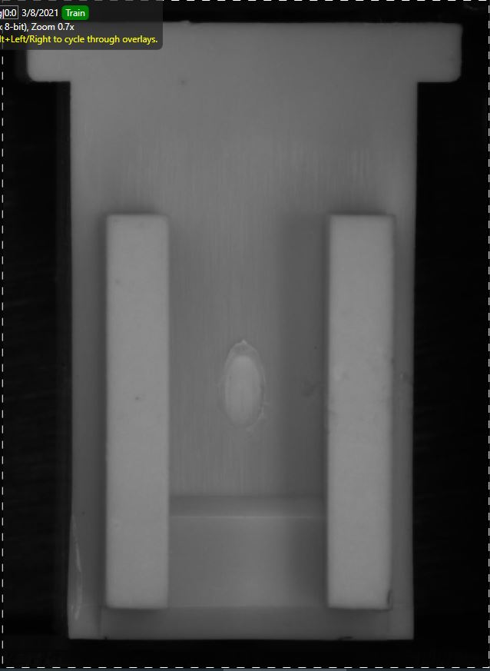
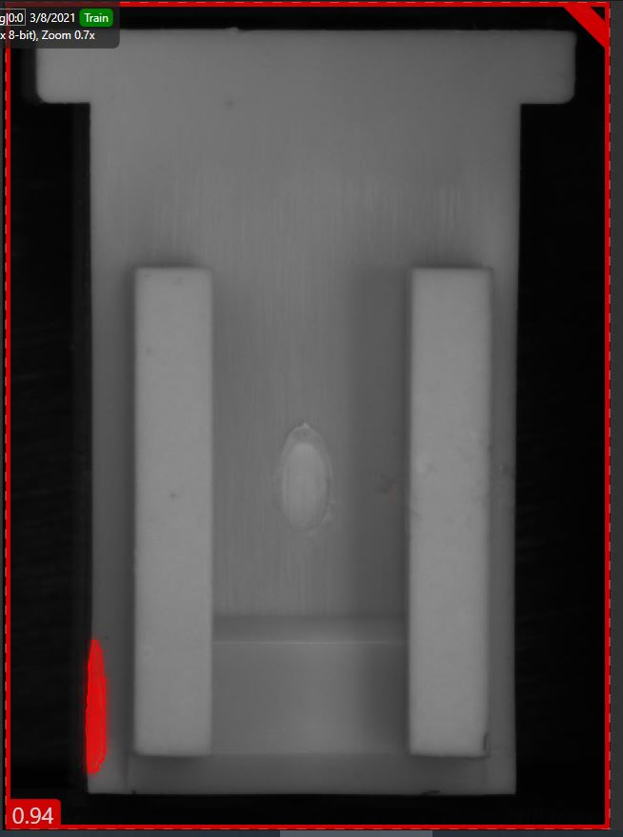
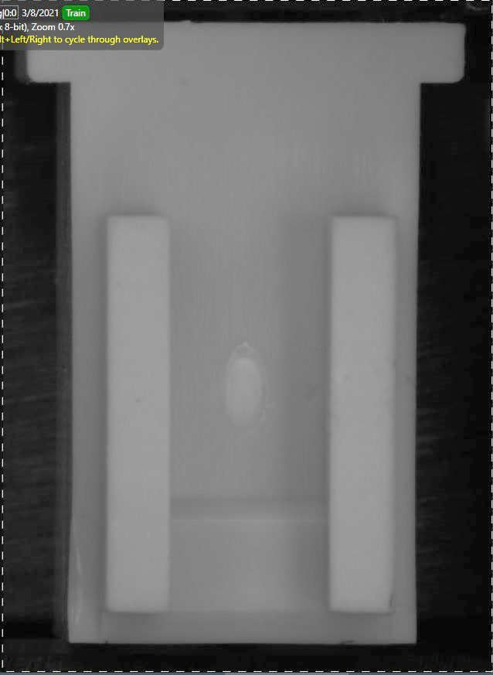
Training model:
Training models with OK, NG image
MXV Design interface
Running
Marking NG
Export runtime library
Request licenses key for training``
3.Advantage of Deep Learning
Good at Check shape and classify
Good at appearance and update type of NG.
Easy to train and update for new models.
Multi type of NG in one times processing.
Easy to user, ease to training technical

Slide 5
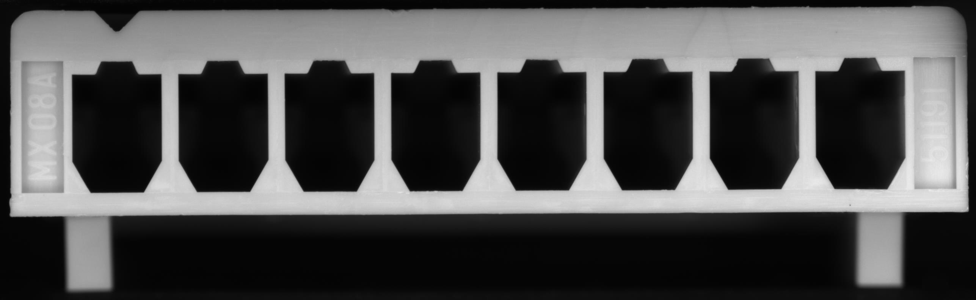
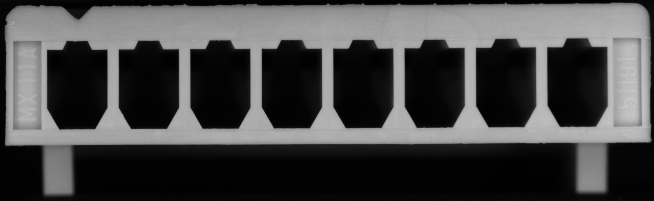
II. problem
1 , phenomenon
From Molding data ( W43 ~W44) : false call rate of machine is very high abnormal
Model 2 ckt tỉ lệ 17%
Model 6ckt tỉ lệ 30%
Model 8ckt tỉ lệ 80%
2, Analysis
False call rate increase verry high: 5% ~ 42% ( average ) .
This vision system using deep learning for detect OK/ NG product ➔ only classify by area check .
NG area
CAM1 – master image
CAM1 – NG image

Slide 6
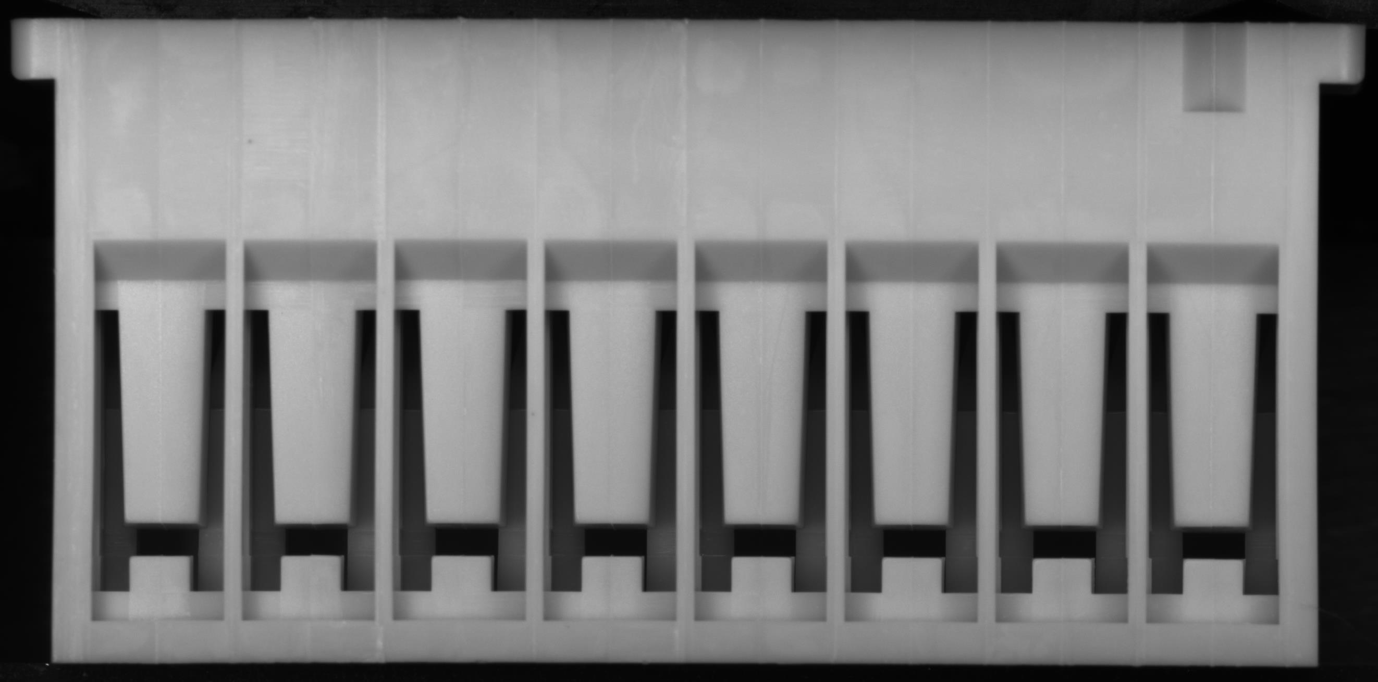
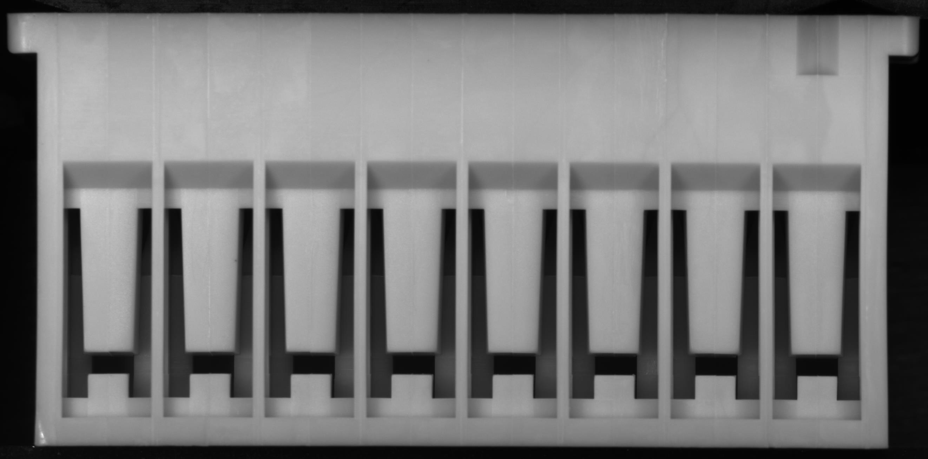
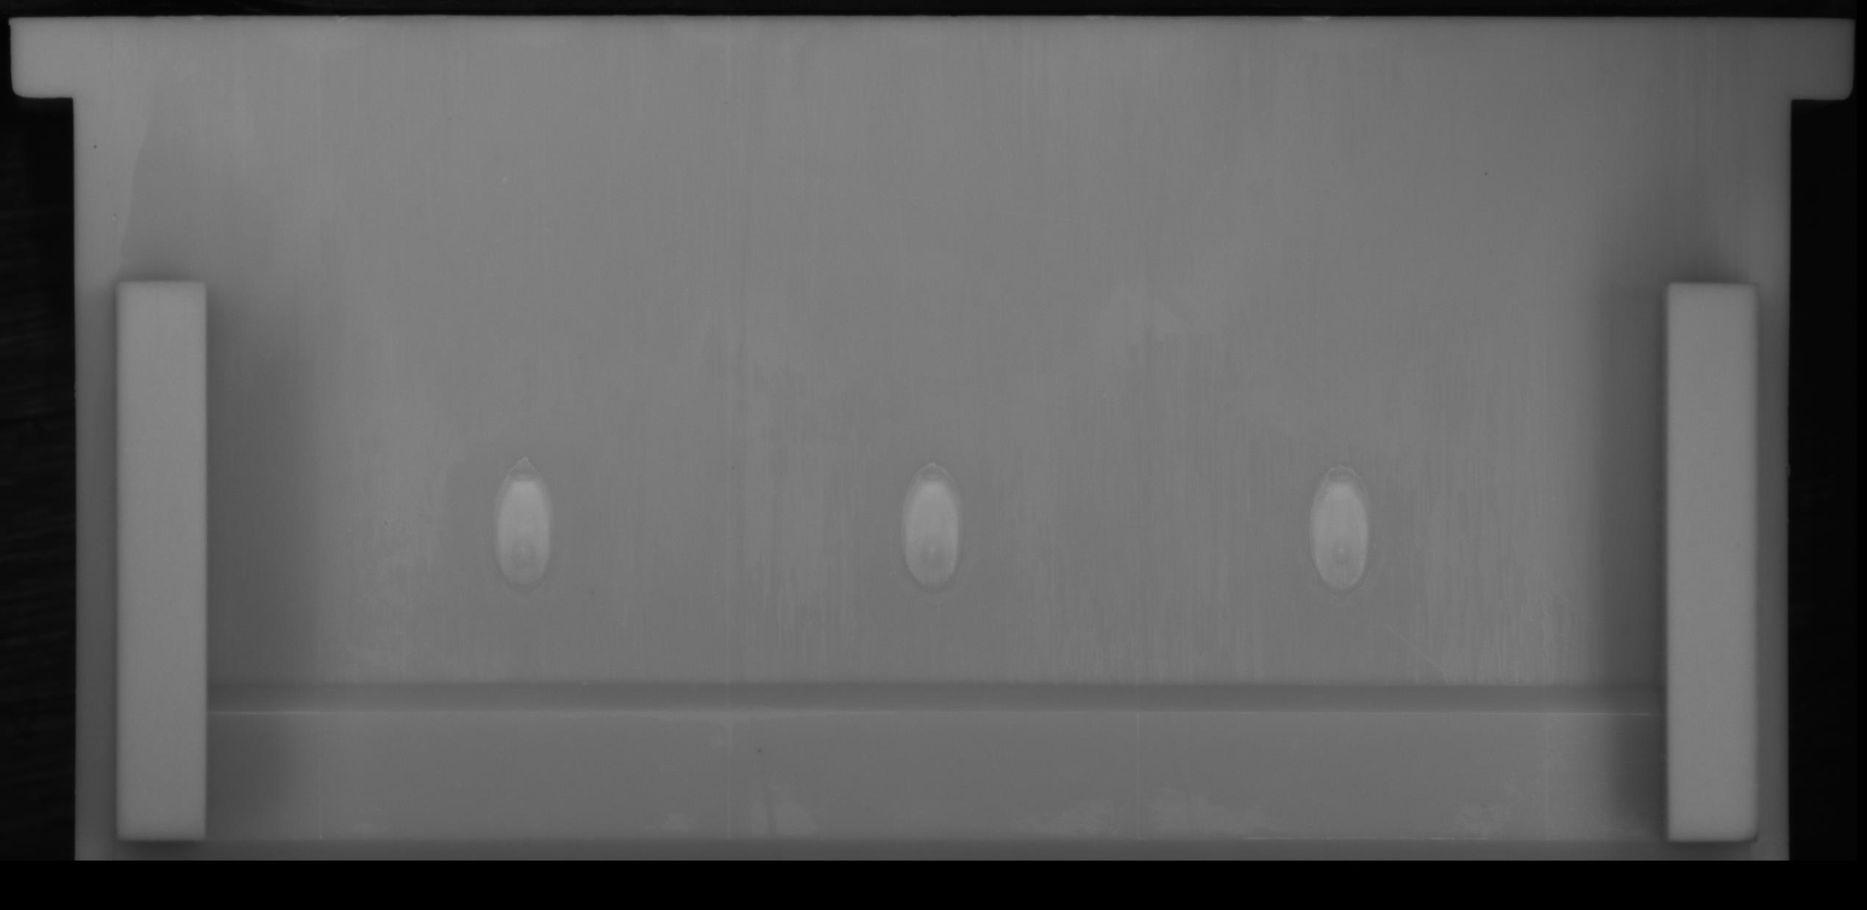
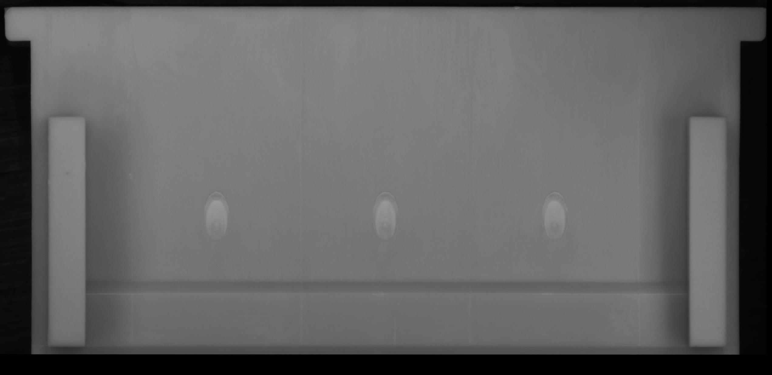
NG area
CAM2 – master image
CAM2 – NG image
CAM3 – master image
CAM3 – NG image
Conclusion : all false call point detect by deep learning vision system is small, they came from production conditions.
need to update new condition of model training .

Slide 7
III. Proposal solution
Machine have to update new conditions of sample product follow slide 4 :
Solution comparisons :
No./ Name | Cost | Time support | Advantage | Disadvantage
1.Order new license key | Very high ( ~2k$ / year) | 3w order . on line support in out plan | Online support for production Support grow up vision team Have Key for testing new project If using long time cost is no too high | -High cost
2. Call service from maker | high | At less 2 day from trouble time | - Low cost / 1 times support | Take long time stop line for support . Depend on maker / project Not high level securities. If using many time support total cost also high -No have training for update new technology of MXV team

